Slide 1
Tutor Agent Presentation
Yason Khaburzaniya
&
Ermolay Beketov

Slide 2
The idea of the AI Tutor
Mission - Maximize learning through engagement
Engagement is a two way street, so robust partnership with the tutor is key
Generate study guide for a topic, then we can keep updating study guide asynchronously given feedback from other agents
Make engaging assessments to reinforce learning
Ask one question at a time
Level user up when they get questions right so that they feel encouraged to keep going
Assessment result to be use for updating study guide for the given topic
As the user is leveling up they will get harder questions to keep them challenged and engaged
For people who prefer listening for convenience, create audio study guides in podcast format
Tried 2 speakers, but couldn’t find a good example
Make interactive so that the person can critique the material or quiz questions, can report problems, or get explanations.
Of these we only got to implement explanations
Ideally these could also trigger events to update study guide or create better quiz questions
Look for cross subject synergy (not fully implemented)
Multi user support through agent checkpointing using agent state threads

Slide 3
AI Agents for Personalized Learning & Tutoring
The user reads study guides generated by LLMs and then answer questions to increase their proficiency level for each topic.
After reading the study guide generated based on a book in the database, the user will gain access to quiz questions generated based on the study guide
To keep quizzes from being boring, we implemented difficulty levels
LLM decides when the user is ready to go the next level as the user is answer questions one by one
Decided to show quiz questions one at a time to keep the user engage and not feeling overwhelmed by many questions
The study progress summary is asynchronously updated by another agent
The study guides are then asynchronously updated based on the the study progress summary
For user convenience all the same features work if the user wants to listen to a podcast style study guide. The user can switch between podcast styles
Topics
Topic 1 Study Guide
Question 1
What is 2+2?
1
…
Topic 1
Learning topic 1
Topic 2
Topic 3
Take Quiz
Submit

Slide 4
Technical Architecture
After experimenting with google and openai models, decided to use gpt-4o
gpt-4o-mini for speed
gpt-4o-mini-tts for audio
We are using 2 agents that maintain state(In memory, later in DB).
The Study Guide Supervisor keeps all the state
The Study Progress supervisor maintains a similar mapping, but fewer fields
Both support multiple users where each user is assigned a different thread
1 agent that doesn’t maintain state gets detailed parameters and uses tools to generate study guides
The study guide generating agent also integrates with a SQL database to pull book chapters from a database(populated from a free textbook found online)
Using LangGraph checkpointer to store agent state and support multiple users
Using Kafka and a PubSub mechanism similar to Google PubSub for asynchronous messaging between agents
Unstructured communication between agents
Because agents are so good at unstructured data, this maximizes flexibility

Slide 5
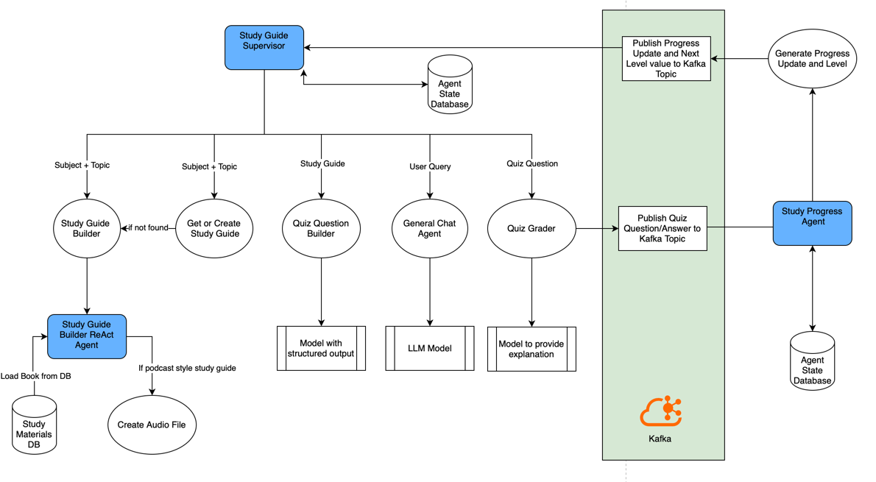
Technical Architecture

Slide 6
Taking the agent to production
Need to hook up to the database to persist agent state to the database
MongoDB may be better at storing documents and images together
Could store image in cloud storage
The current mechanism for managing multiple users is not maintainable, so will need to use a proper data model
Audio will need to be stored on Cloud storage
S3, GCS, Blob Storage
Setup secure login
Proper input validation at endpoints and data sanitization for app security
Polish the UI
Make Quiz Question view more engaging
Level grades/downgrades more fun and logic more transparent
Allow report issues with data and regenerating study guides at will
Create UI for reviewing study progress
Create a test suite for verifying correctness and consistent outputs
Can you use cheap and fast LLMs to test using focused prompts.

Slide 7
Code review
Supervisor agent with a mix of deterministic and non-deterministic routes
PubSub with multi-endpoint subscription for event driven architecture
Code can be made more generic with less duplication
Study guide builder react agent with db RAG integrating with study materials database + audio generation
Study progress agent
Flask app
Front end
User store(mimics database)

Slide 8
Future Enhancements
Responsible AI
Use deterministic algorithm for level calculation otherwise it becomes opaque and confusing
Improve citations. Right now citation is for the book used to generate study guide. Should really cite every sentence
Allow reporting of issues with the data
Reduce hallucinations by using embeddings models to verify that text generated by the AI is found in source material
Reduce hallucinations by having a swarm of agents check each sentence for having bases in the source material
UI
Short focused study guide to dwell into weak areas
Interacting with the study guide to get explanations of selected text
Text interactions with study guide to allow regeneration, or live updates
Streaming of study guide text to the page to allow seeing text as soon as possible
Make audio player better and also allow shorter versions of focused study
Images in the study guide
Update cross subject/topic study guides (half done)
Architecture
Improve agent interactions with more agents using PubSub (for example generating quiz questions asynchronously)
Async and Streaming for agents for better latency
Need to protect against race conditions
Audio
Update to generate podcast with two speakers

Slide 9
Challenges/Learnings
Learned that some models do not support supervisor multi-agent design
Struggled with gemini models until gpt-4o made thing a lot easier
Good understanding of data model is key, otherwise have to replumb the data at every step
Can use agent checkpointer and store entire agent state into database.
Convenient, but not sure it is scalable
Working with Math Study guides from UI and correctness standpoint is very hard

